Slide 1

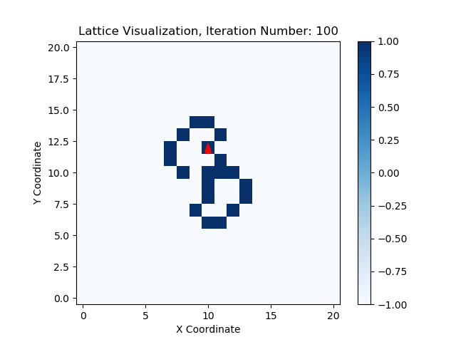
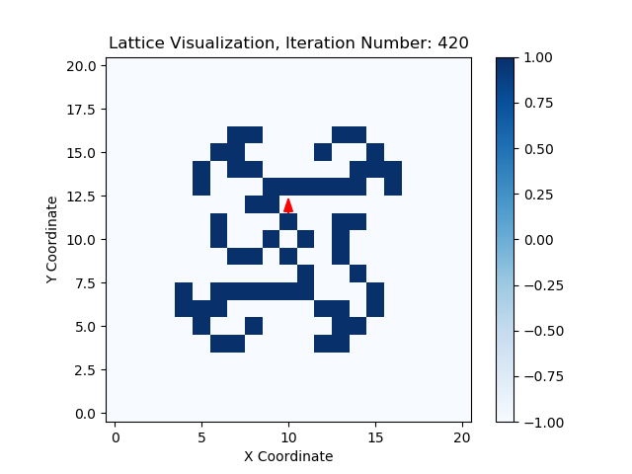
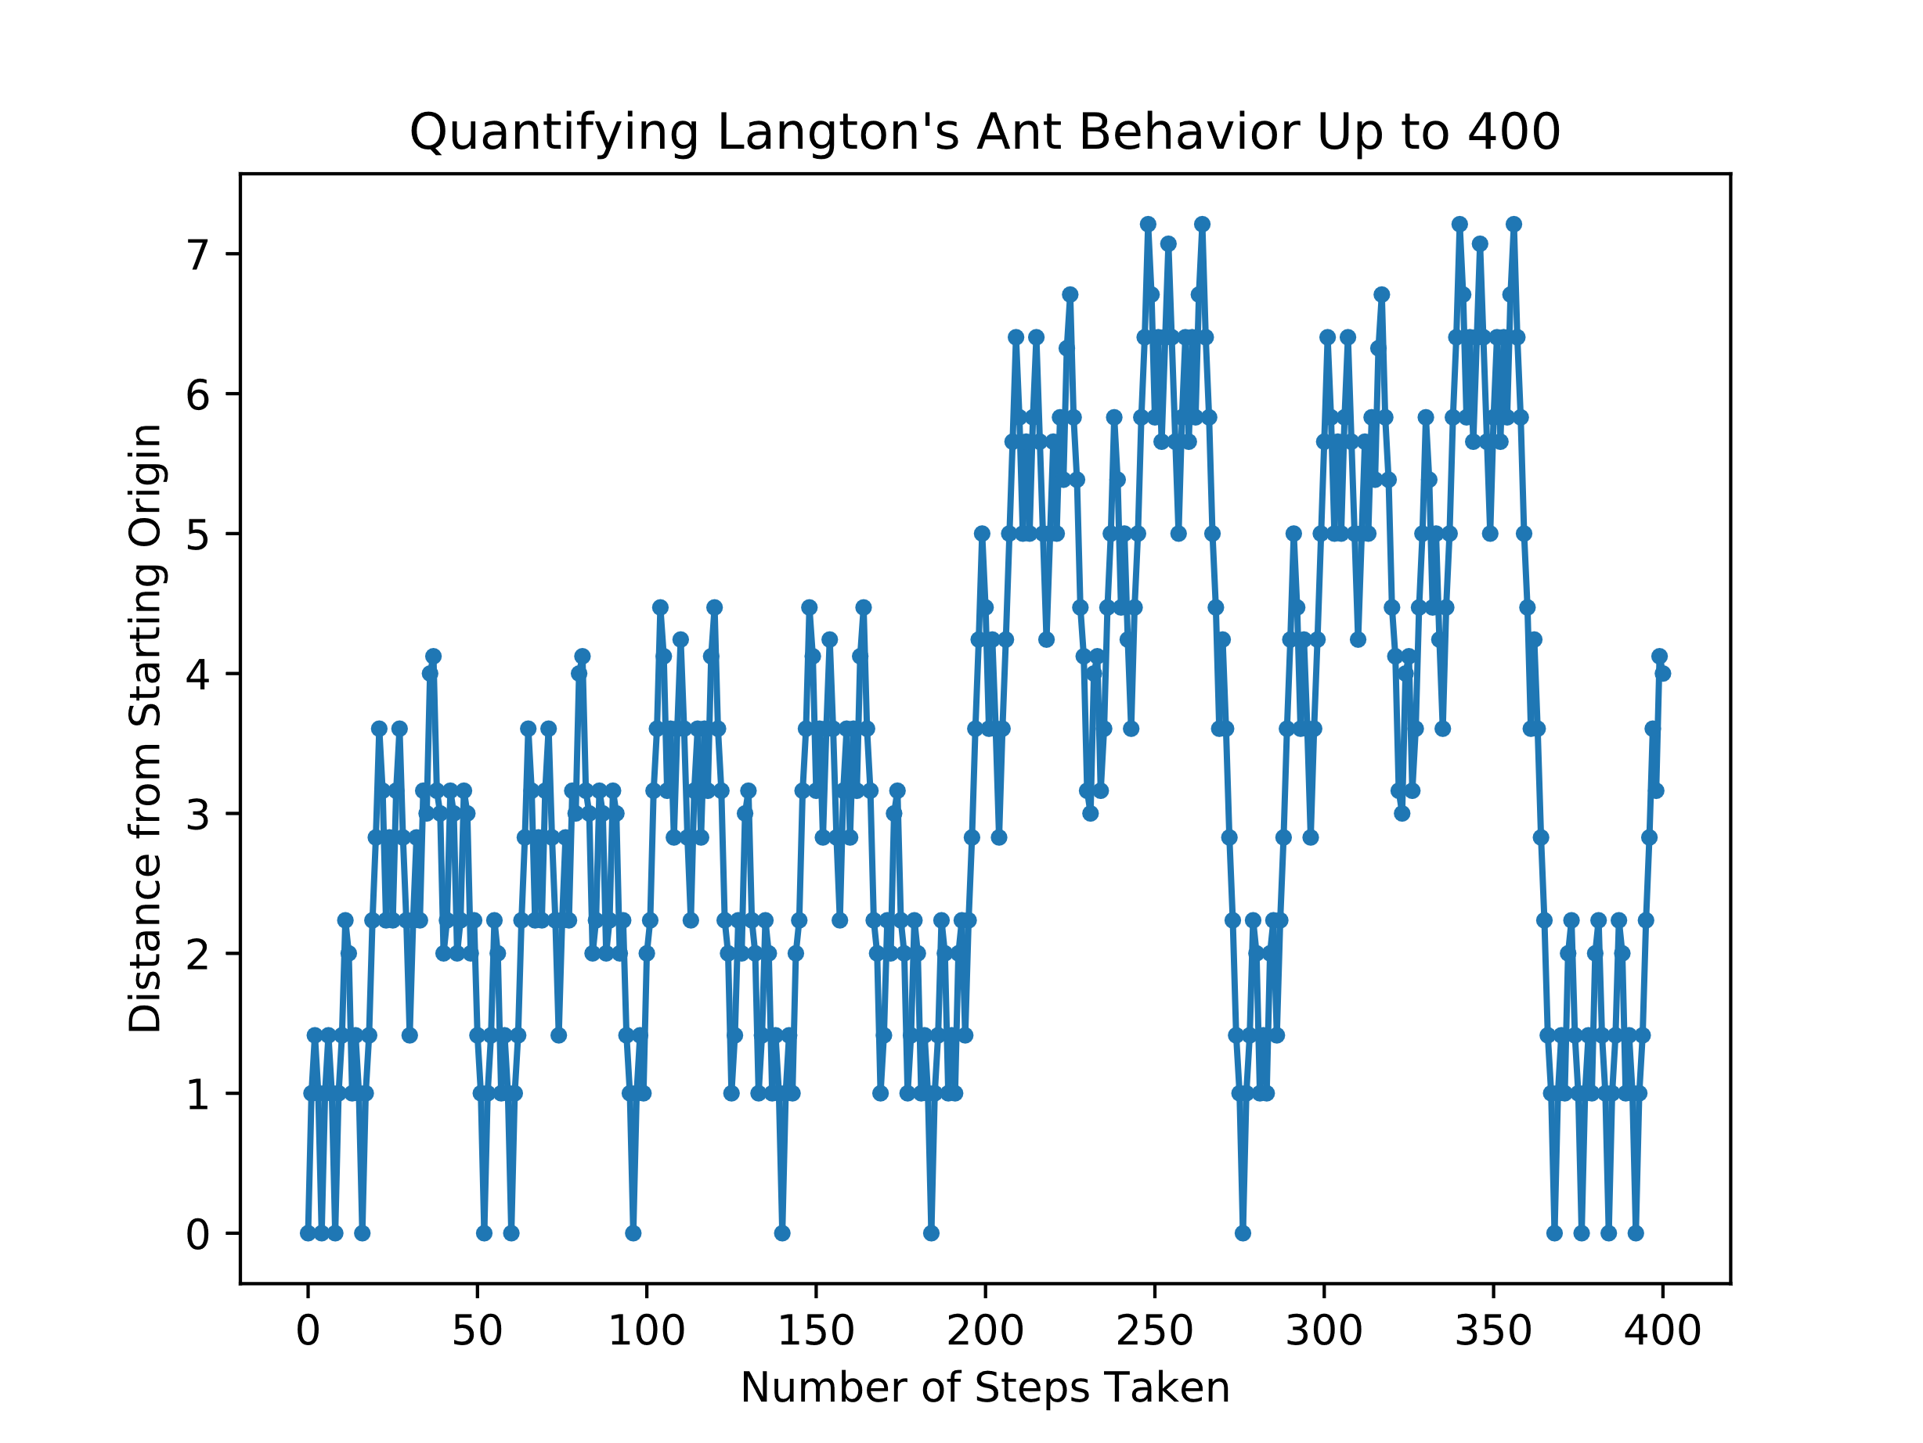
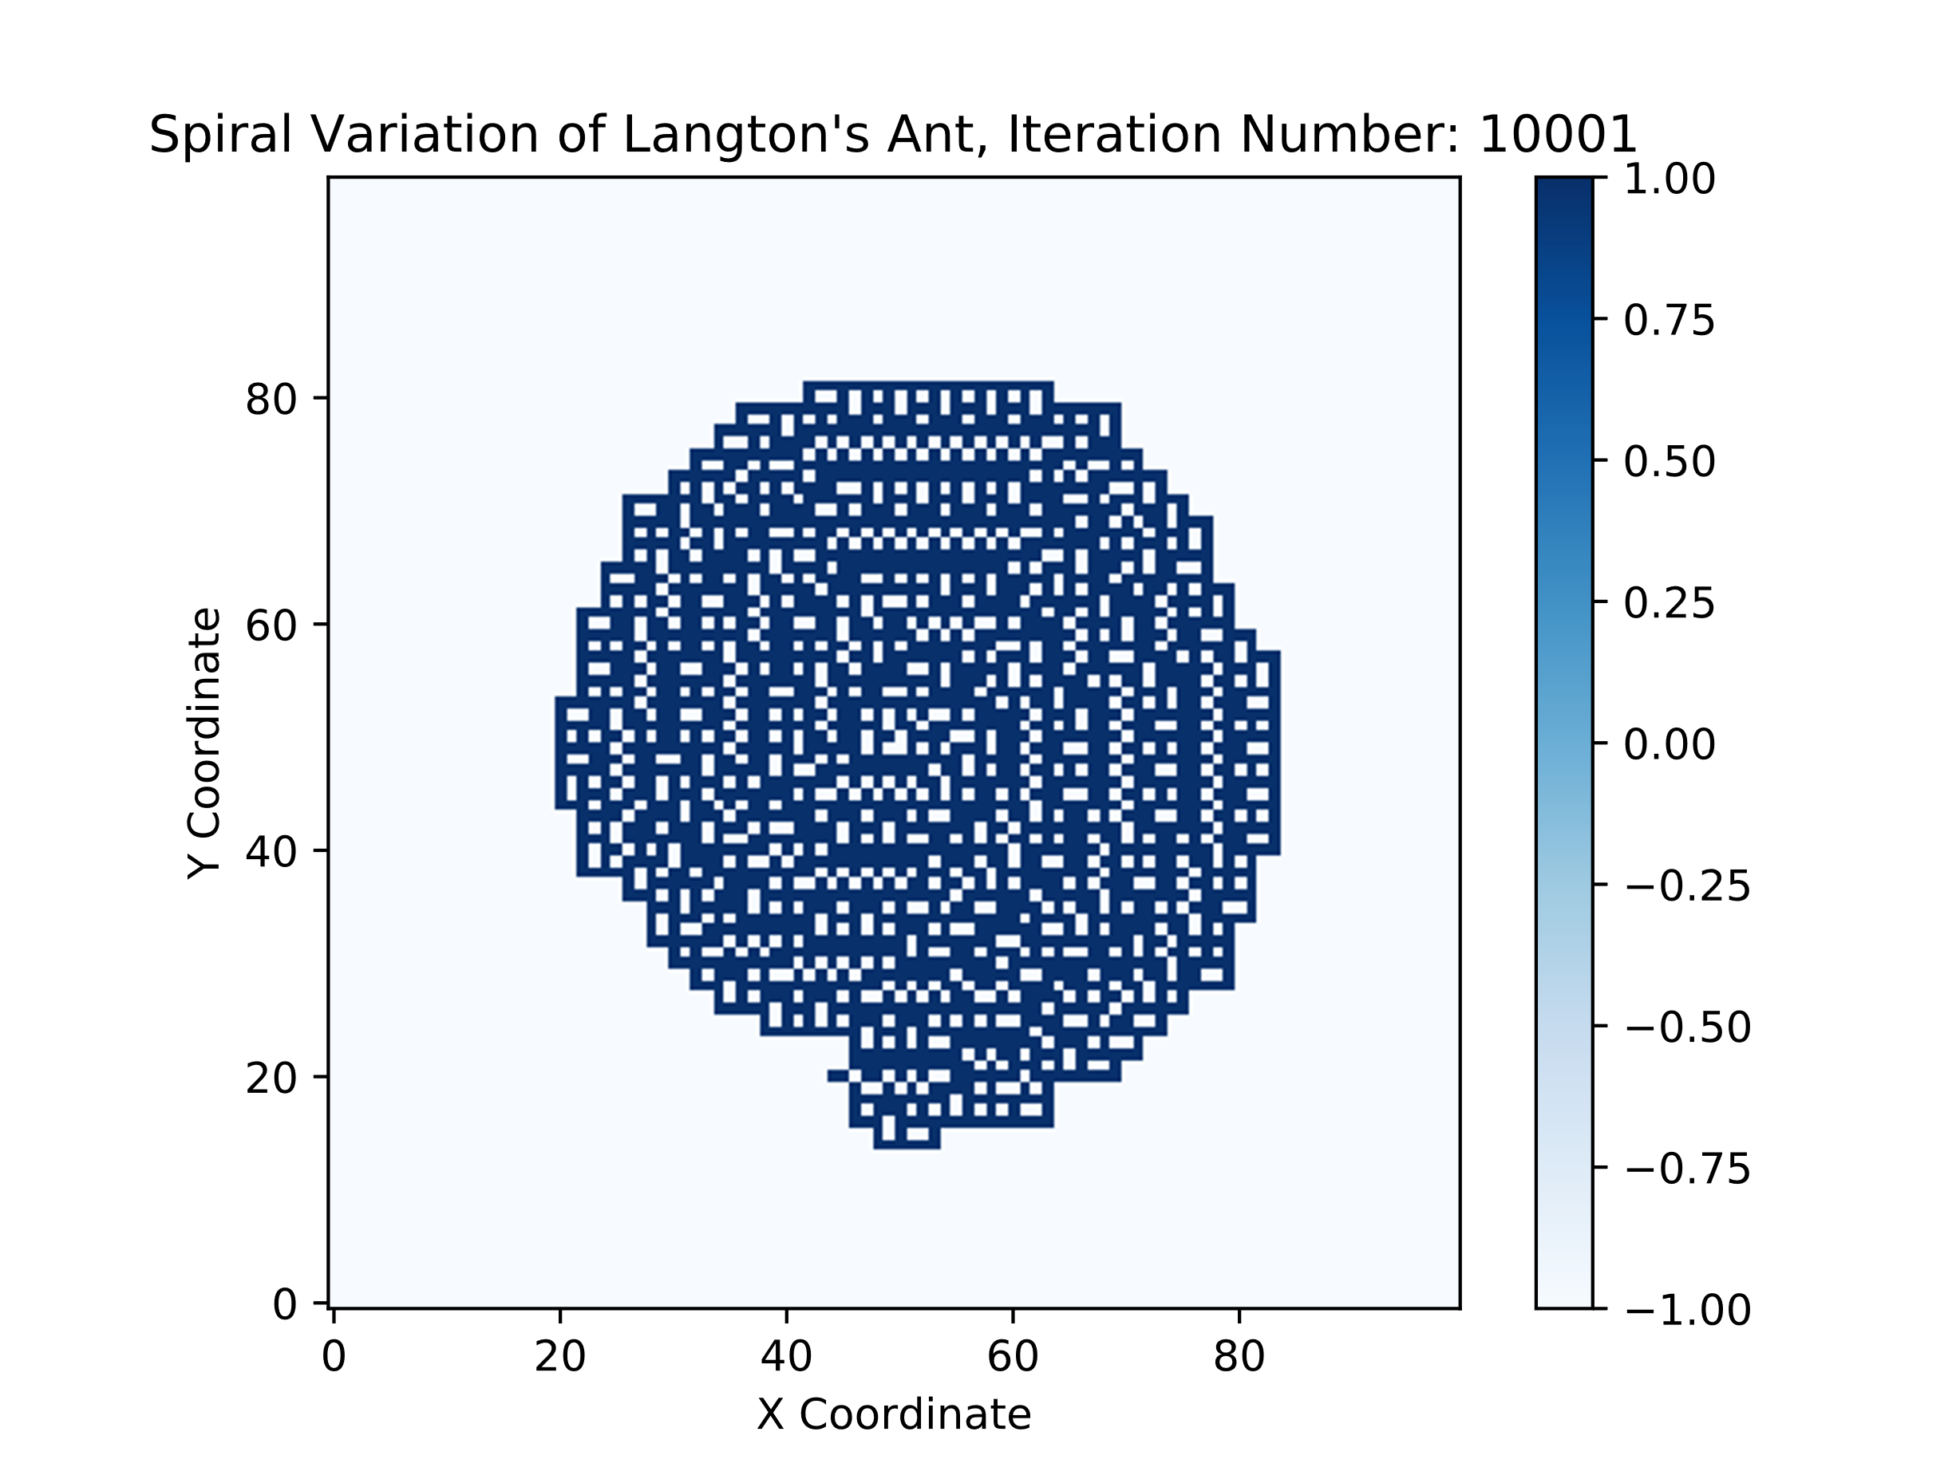
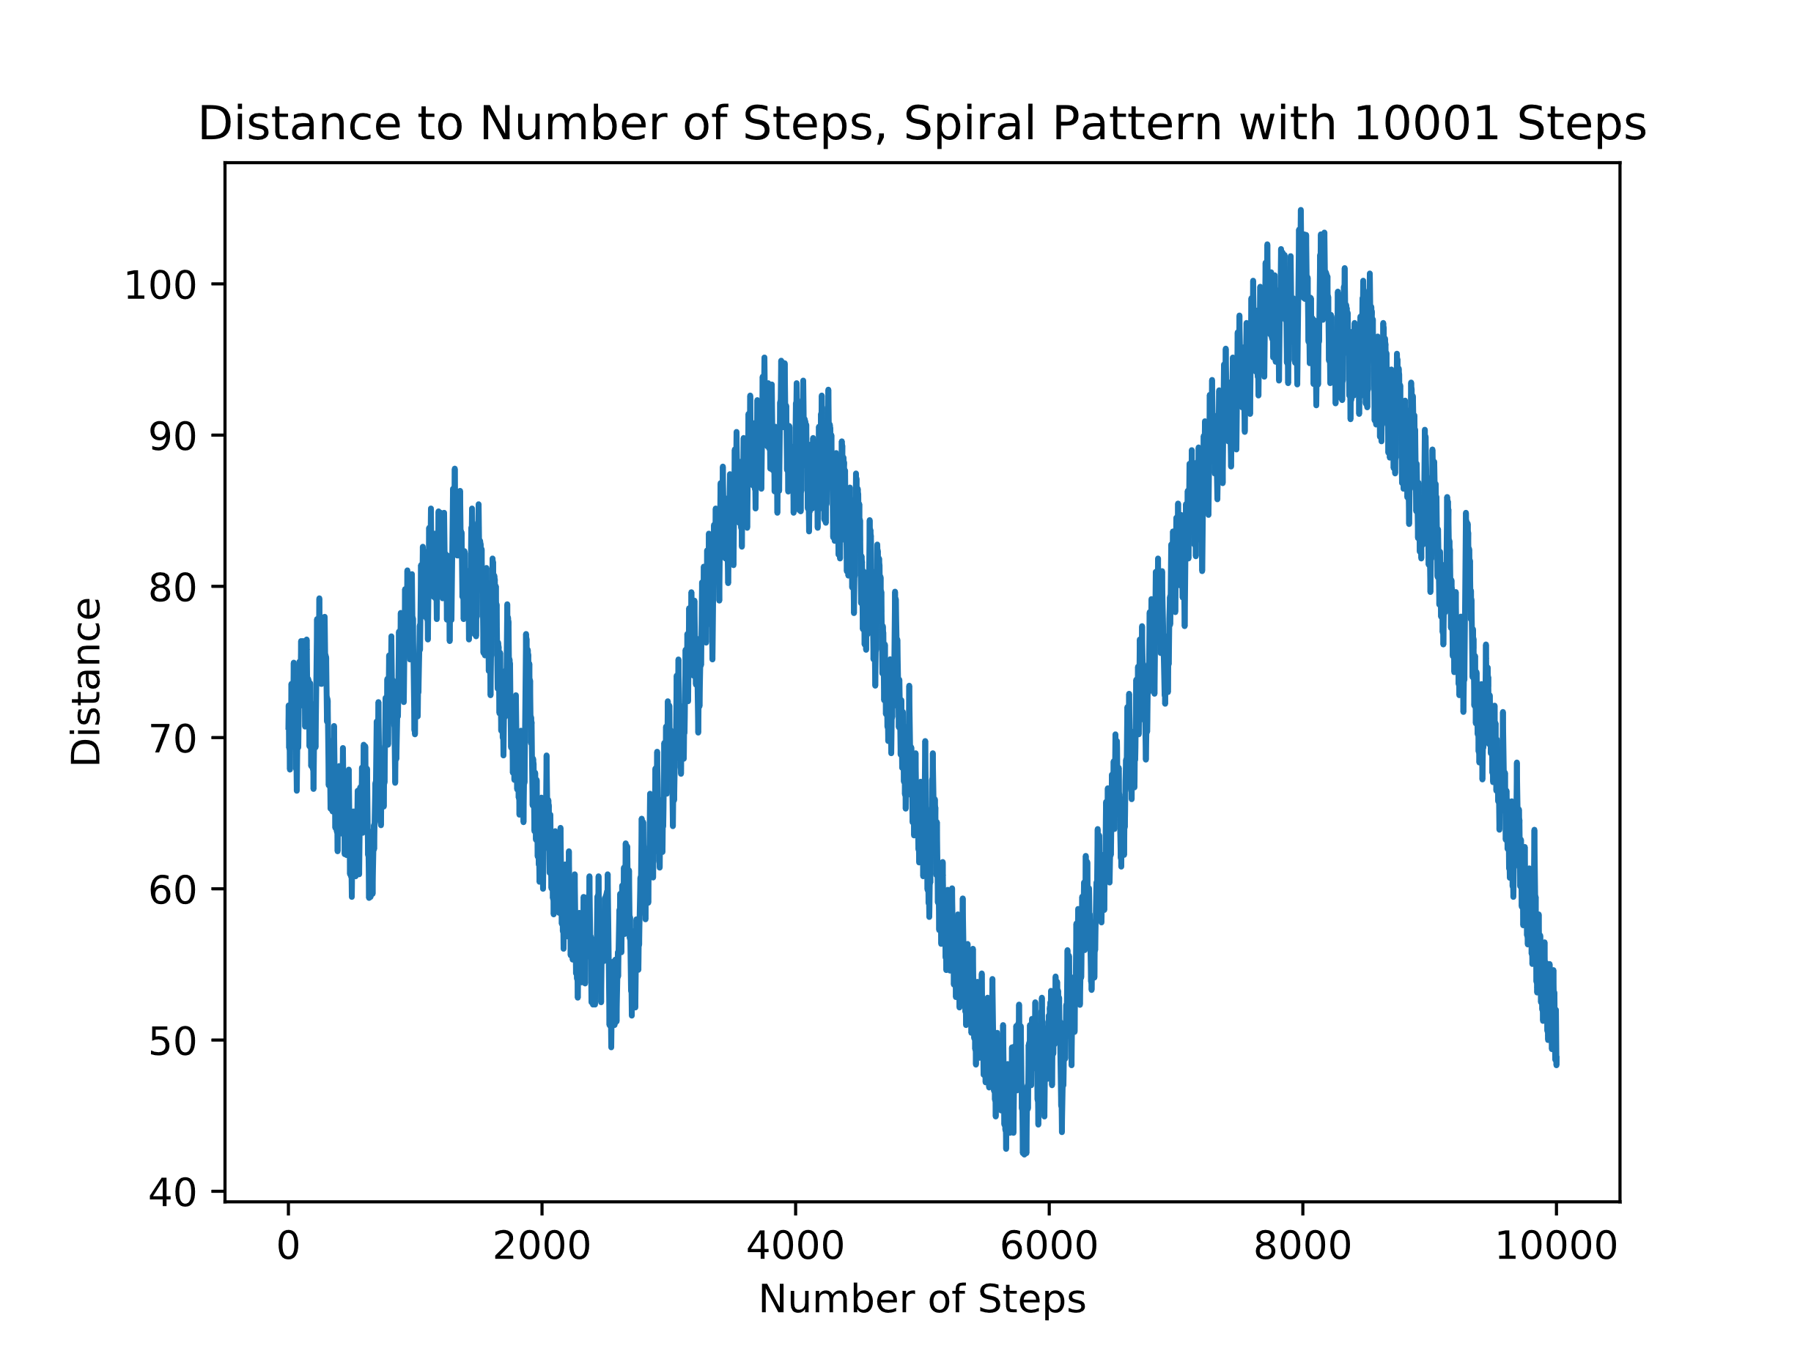
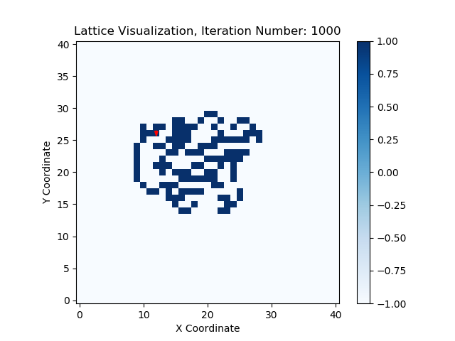
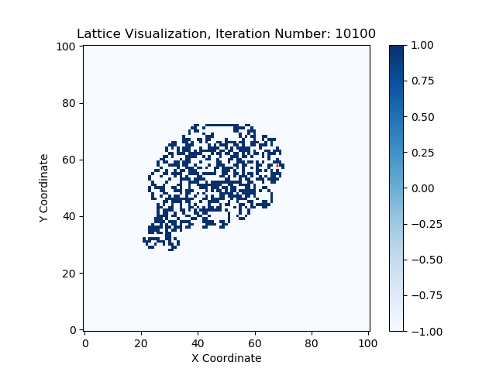
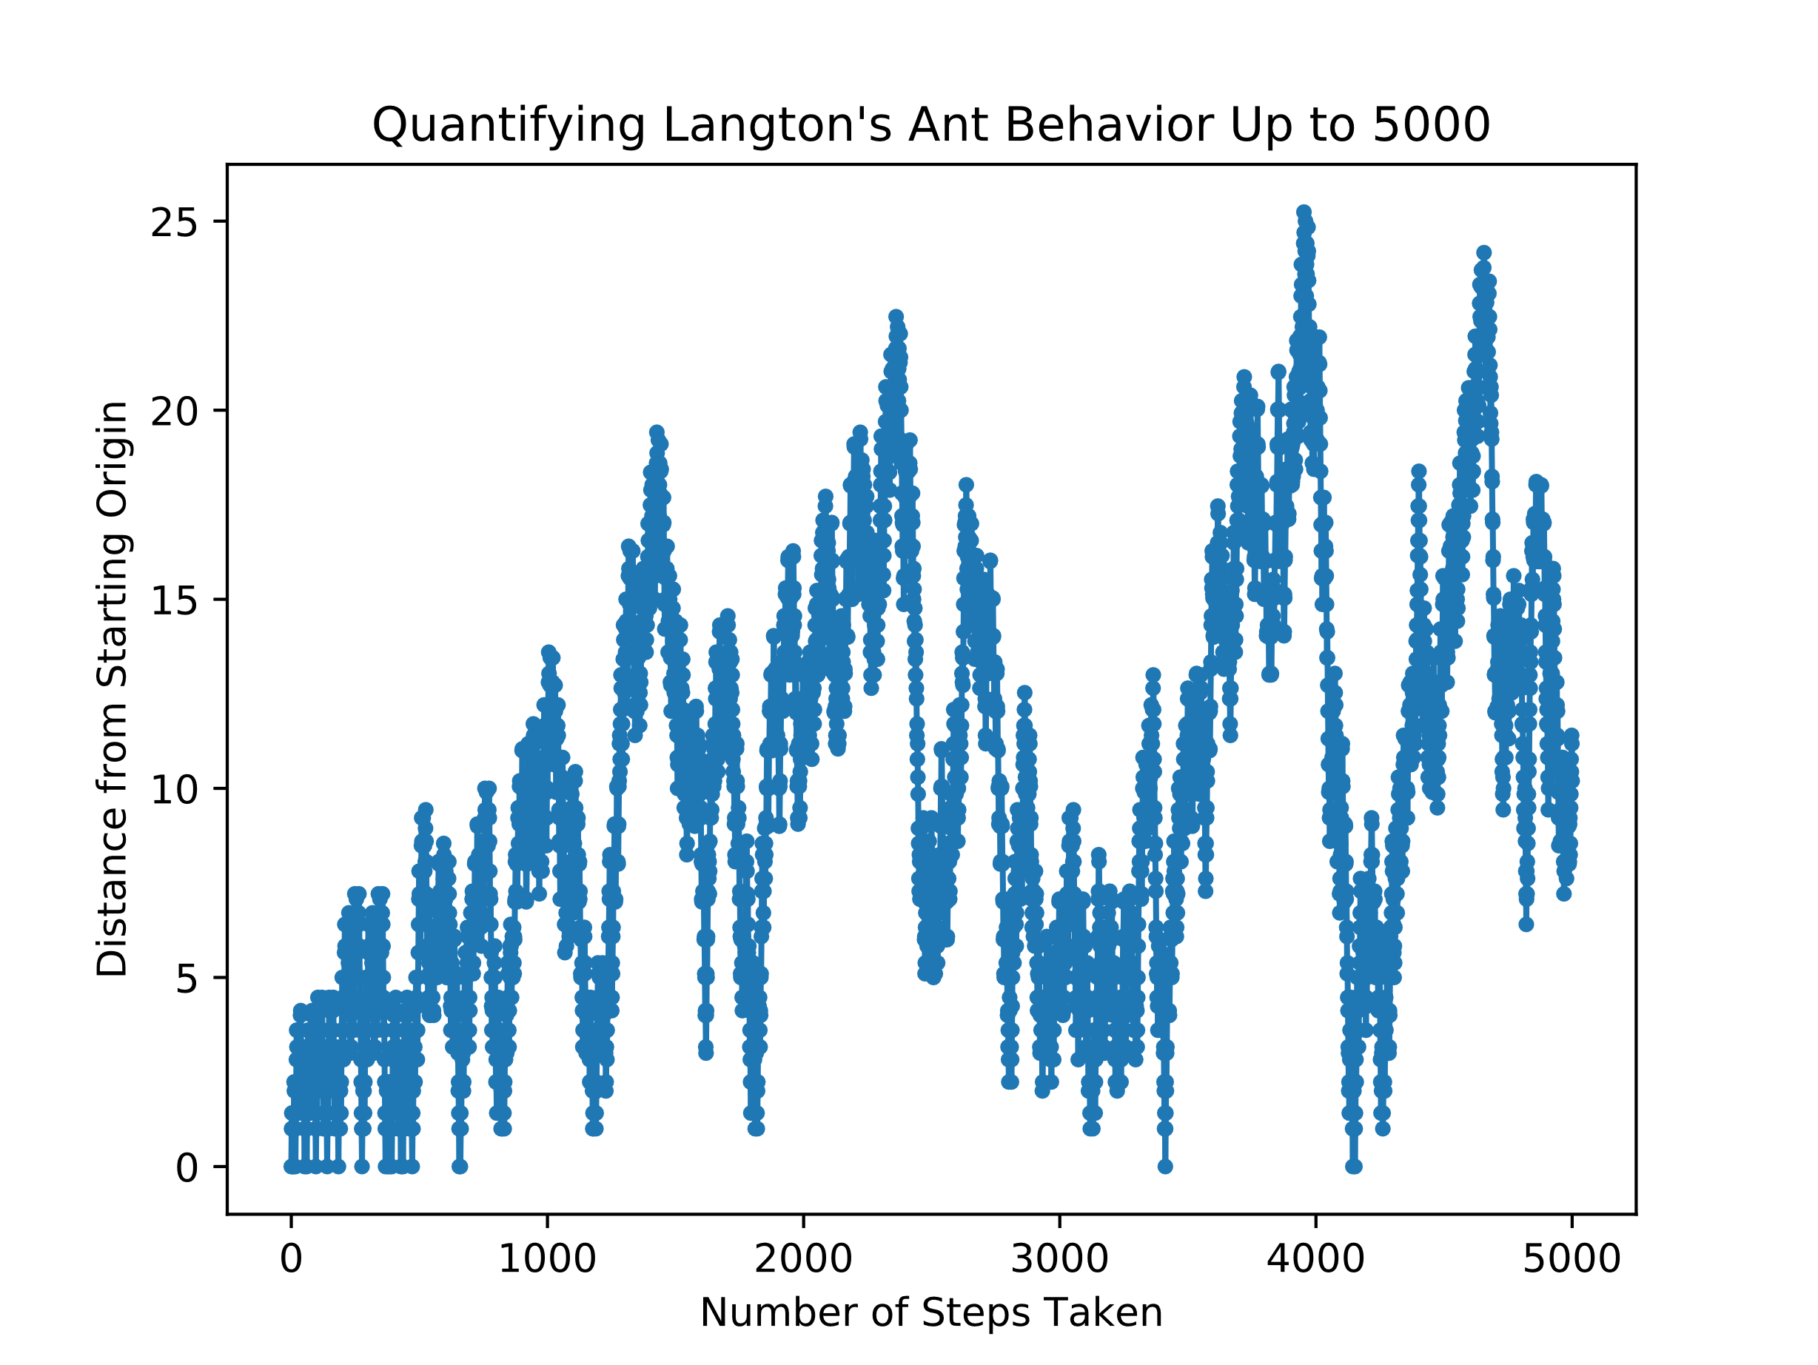
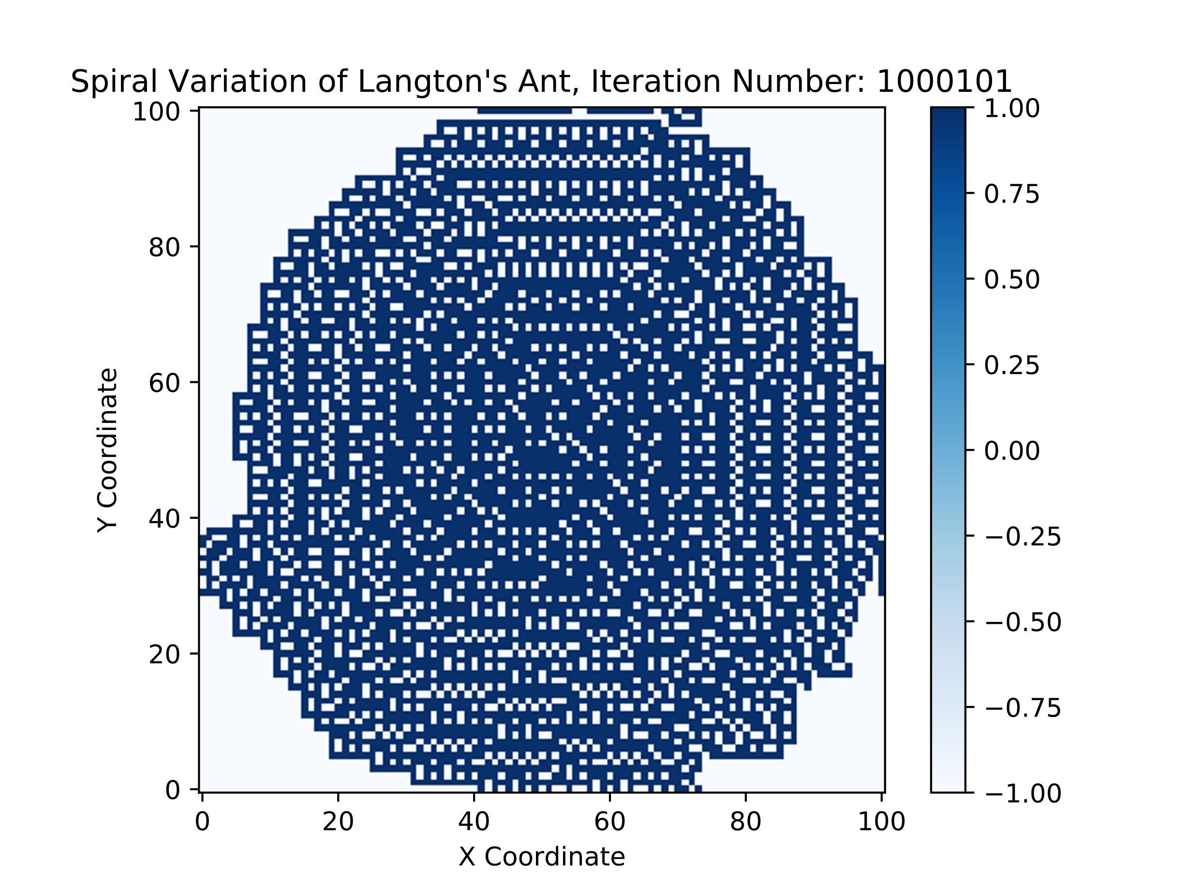
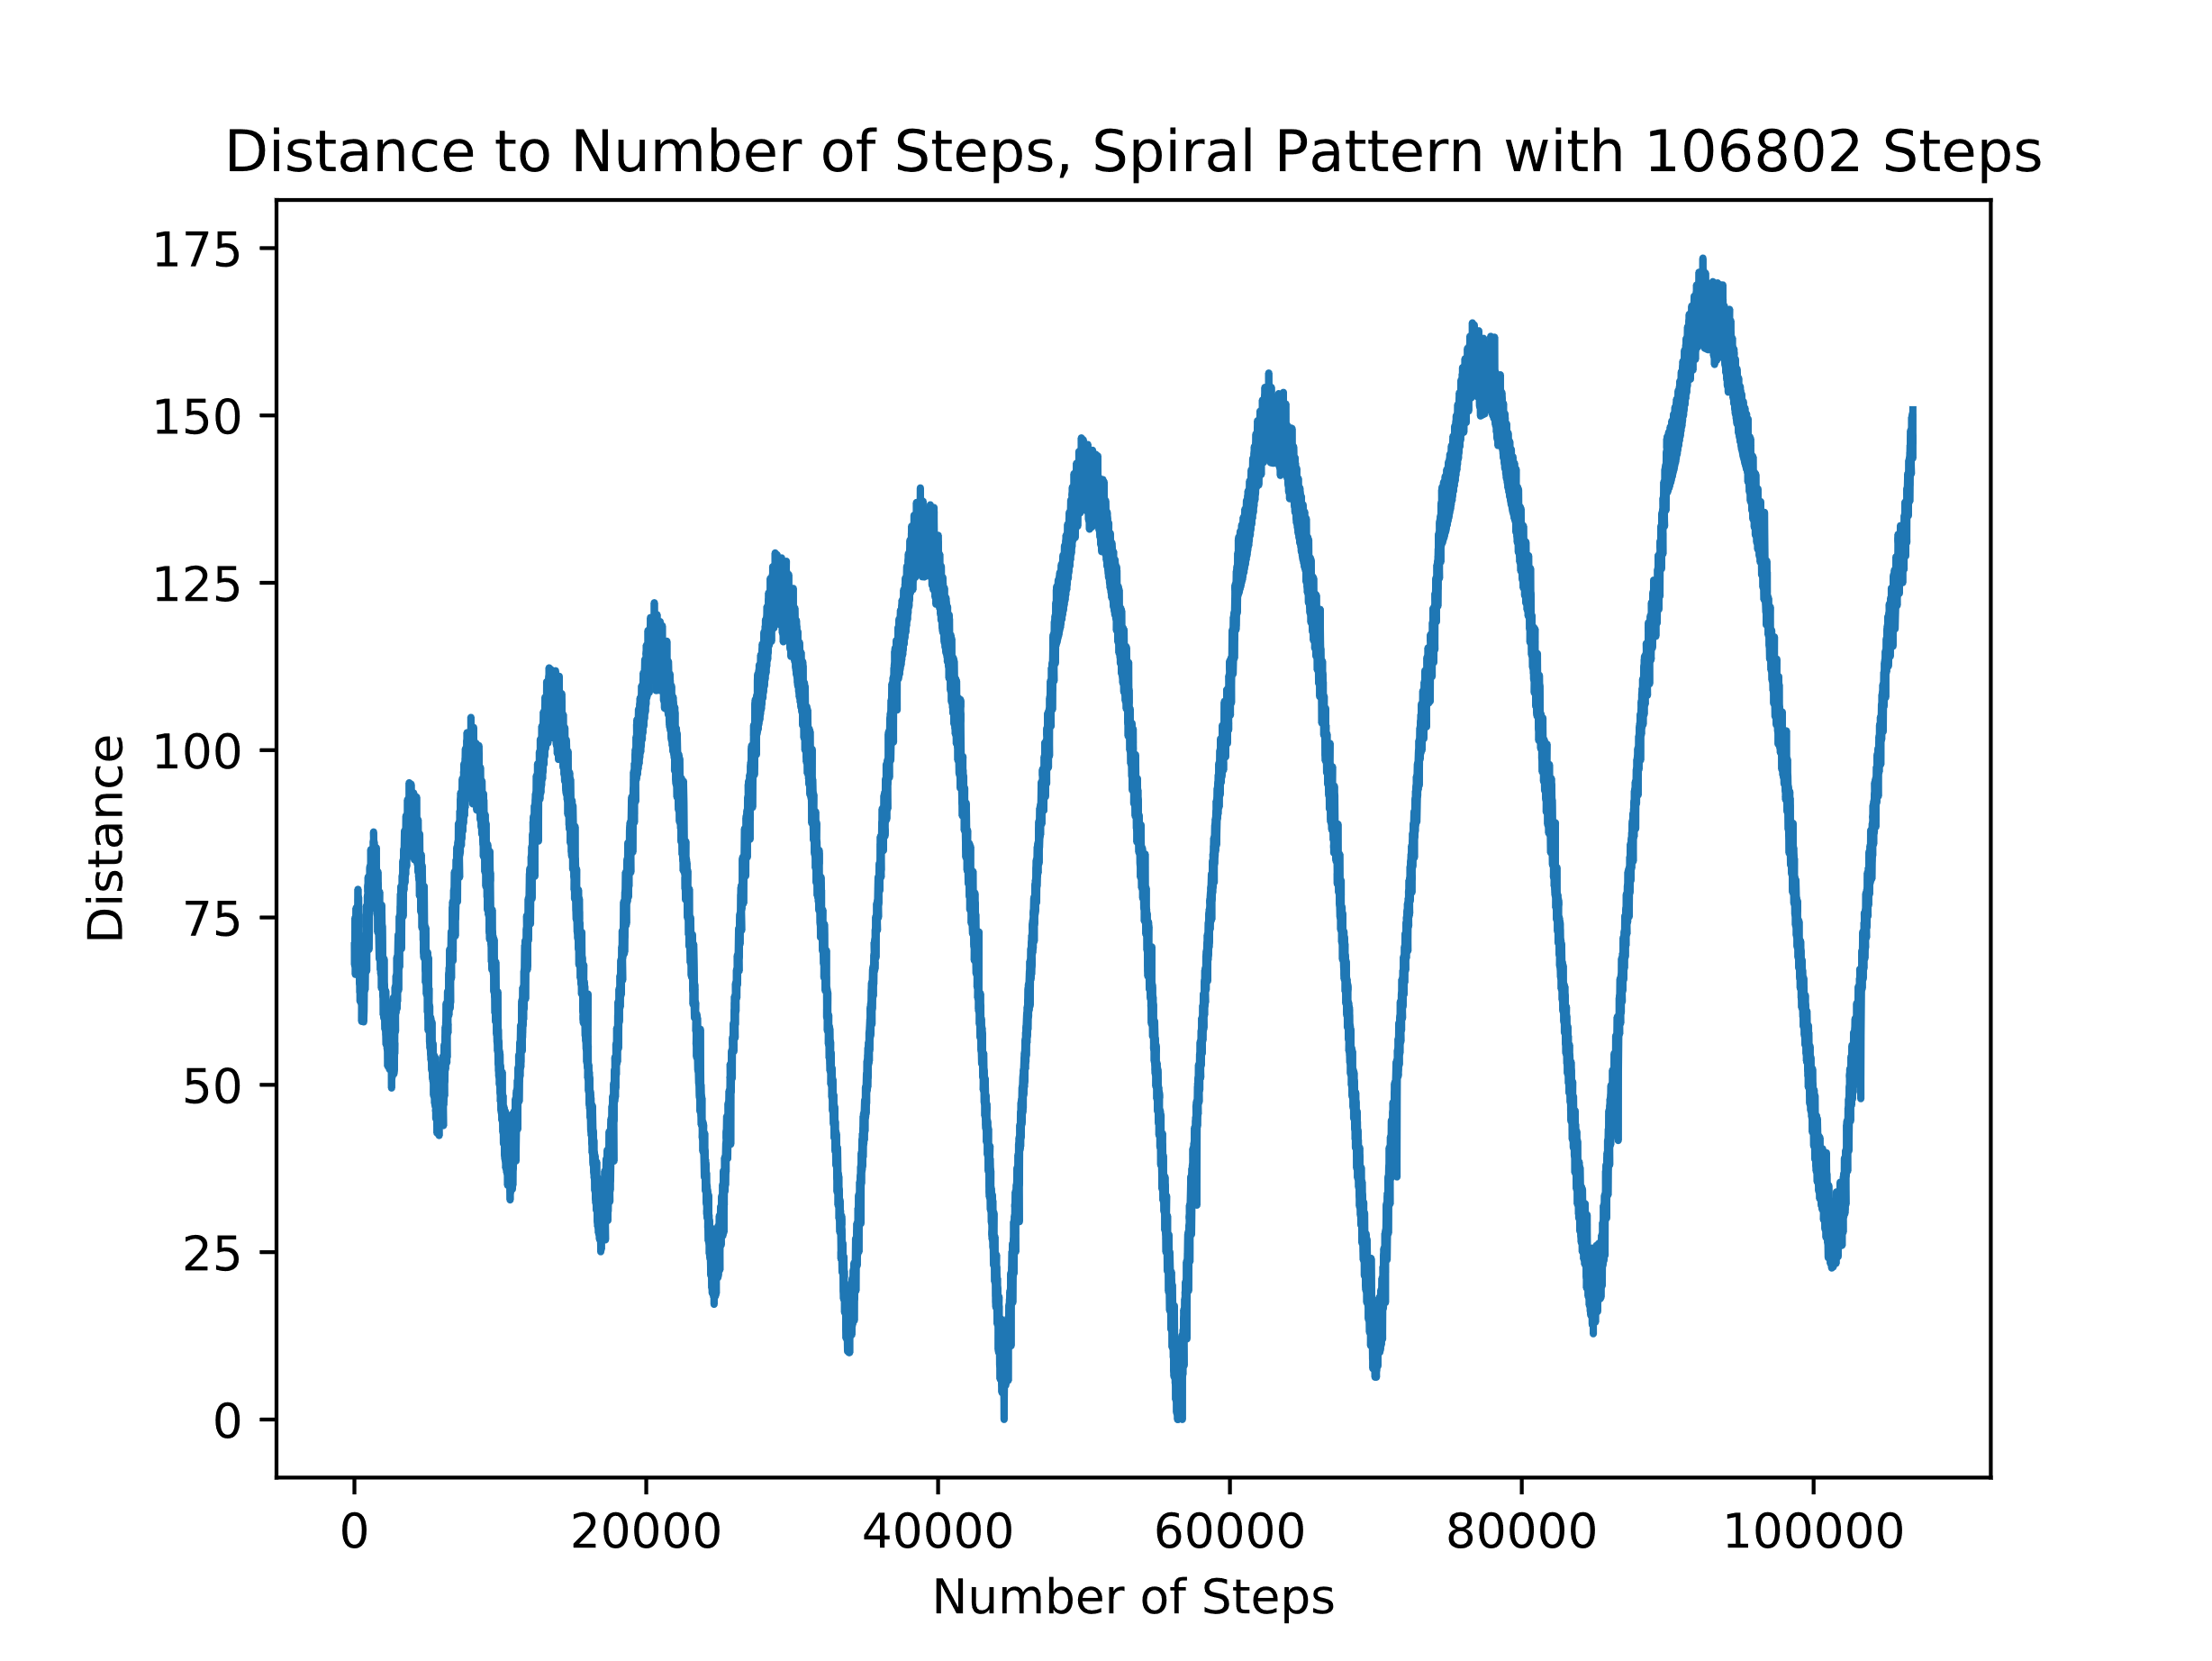
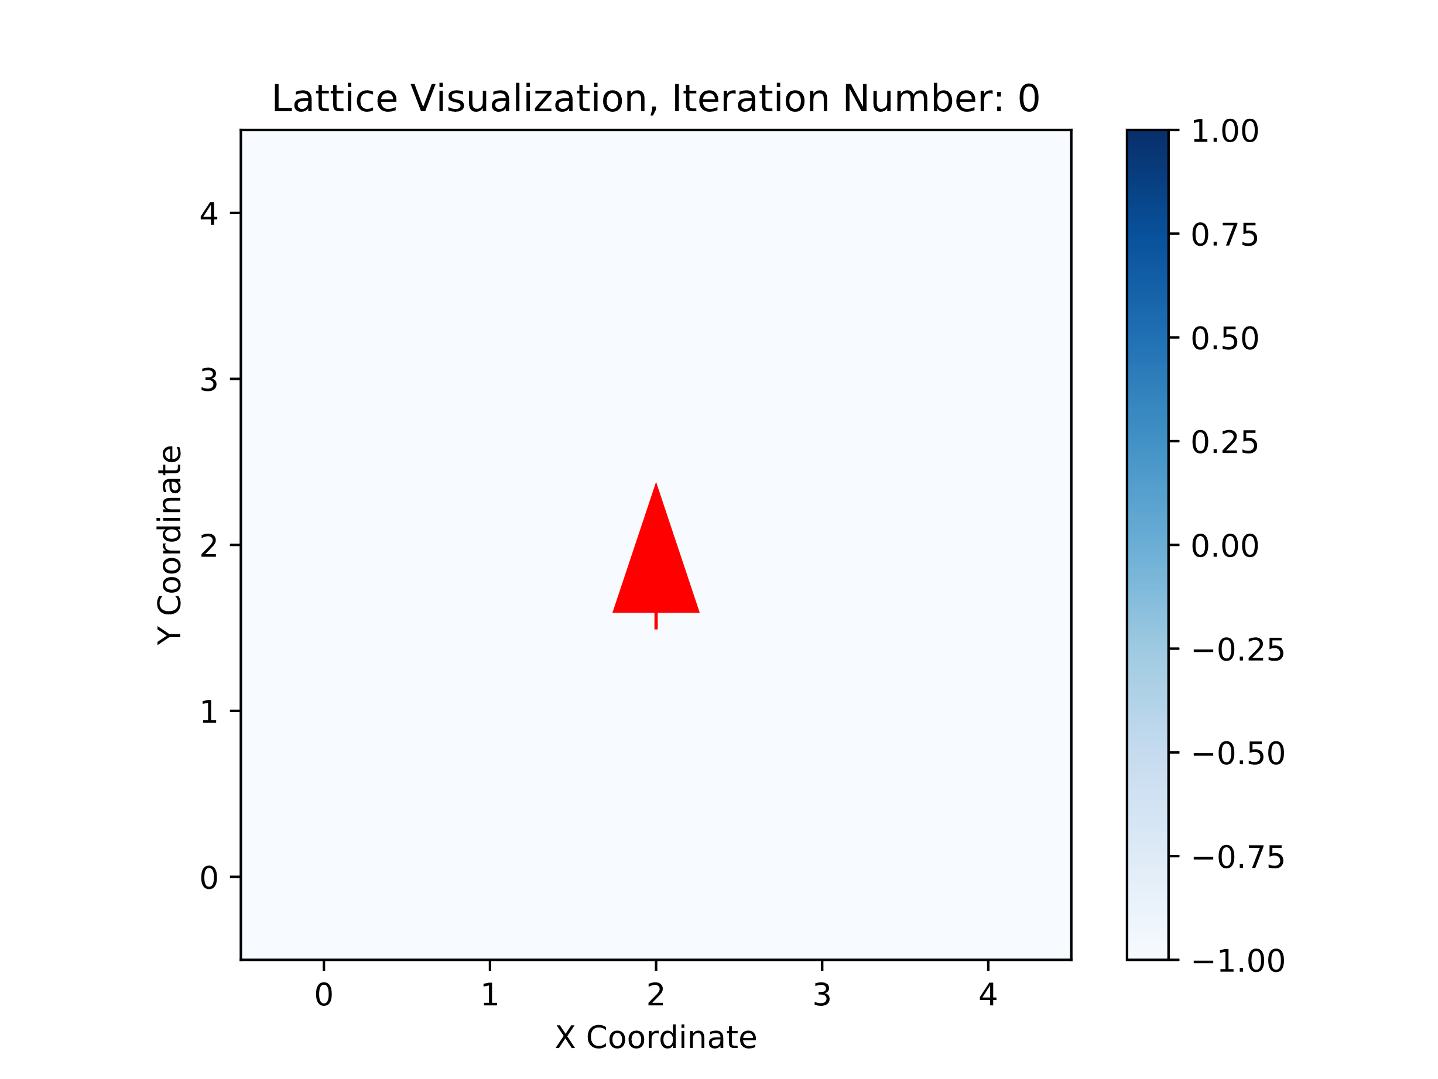
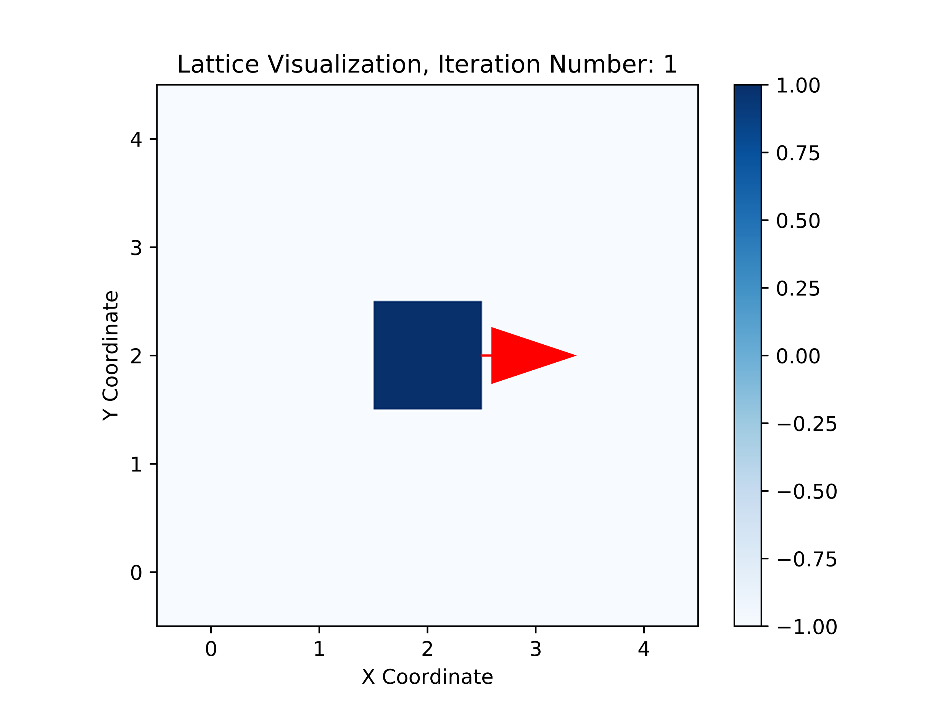
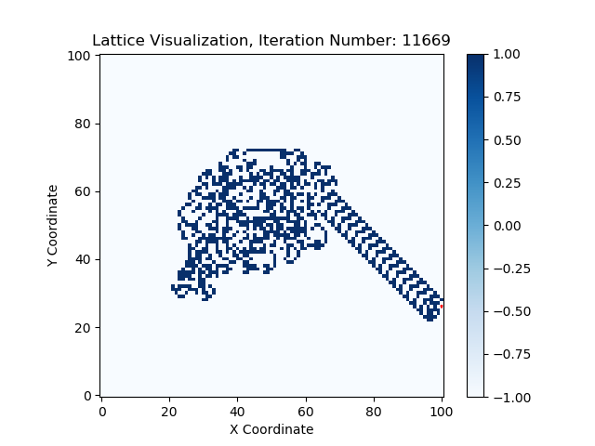
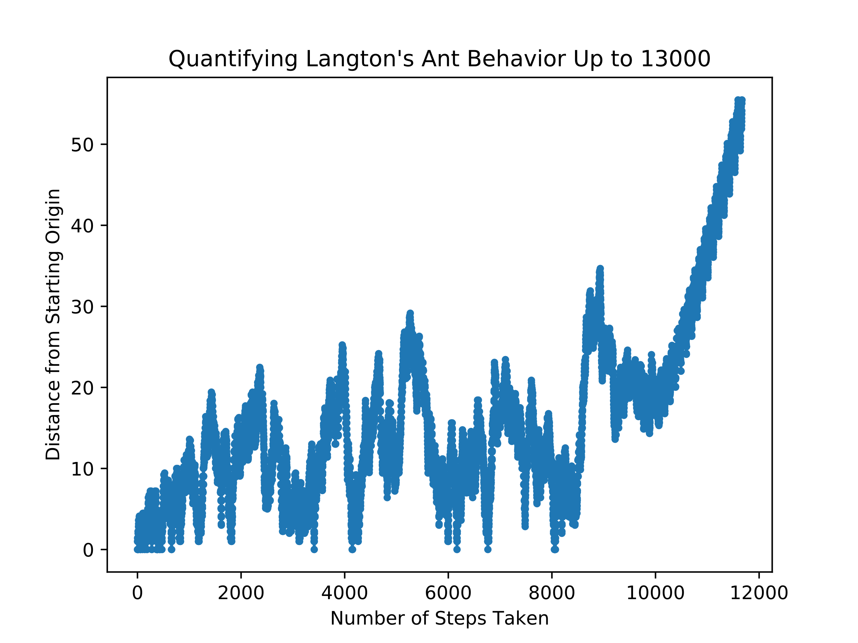
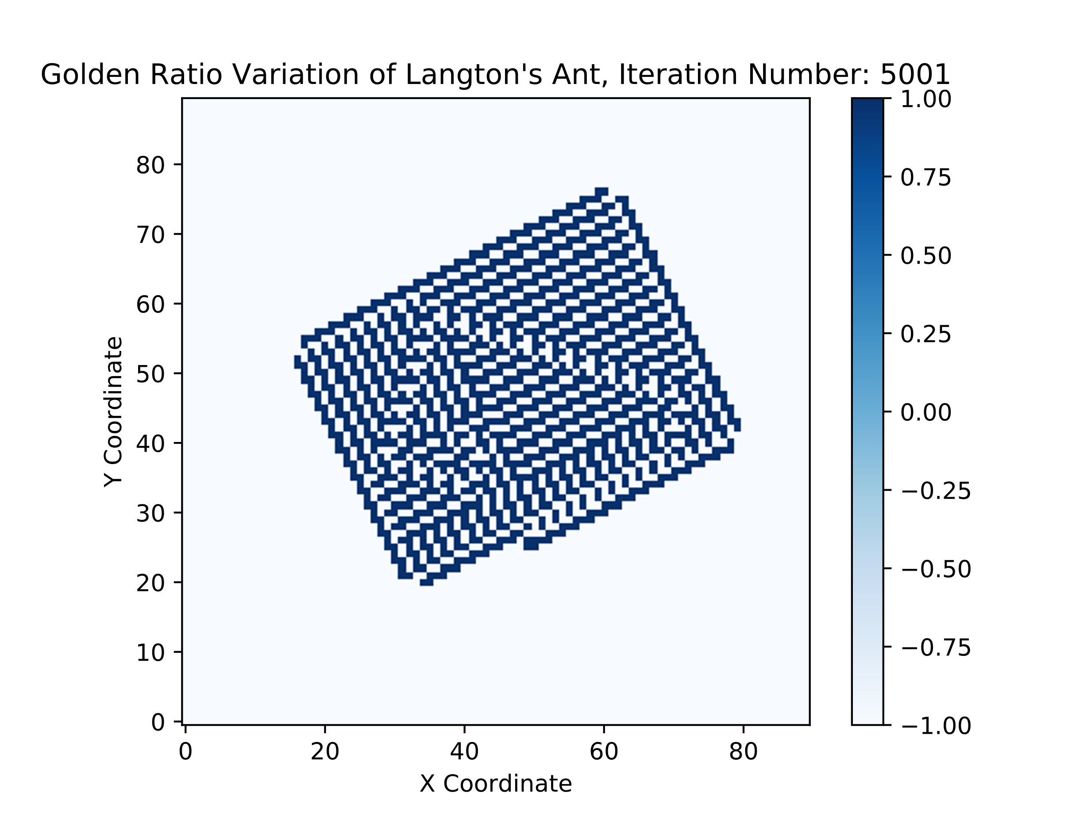
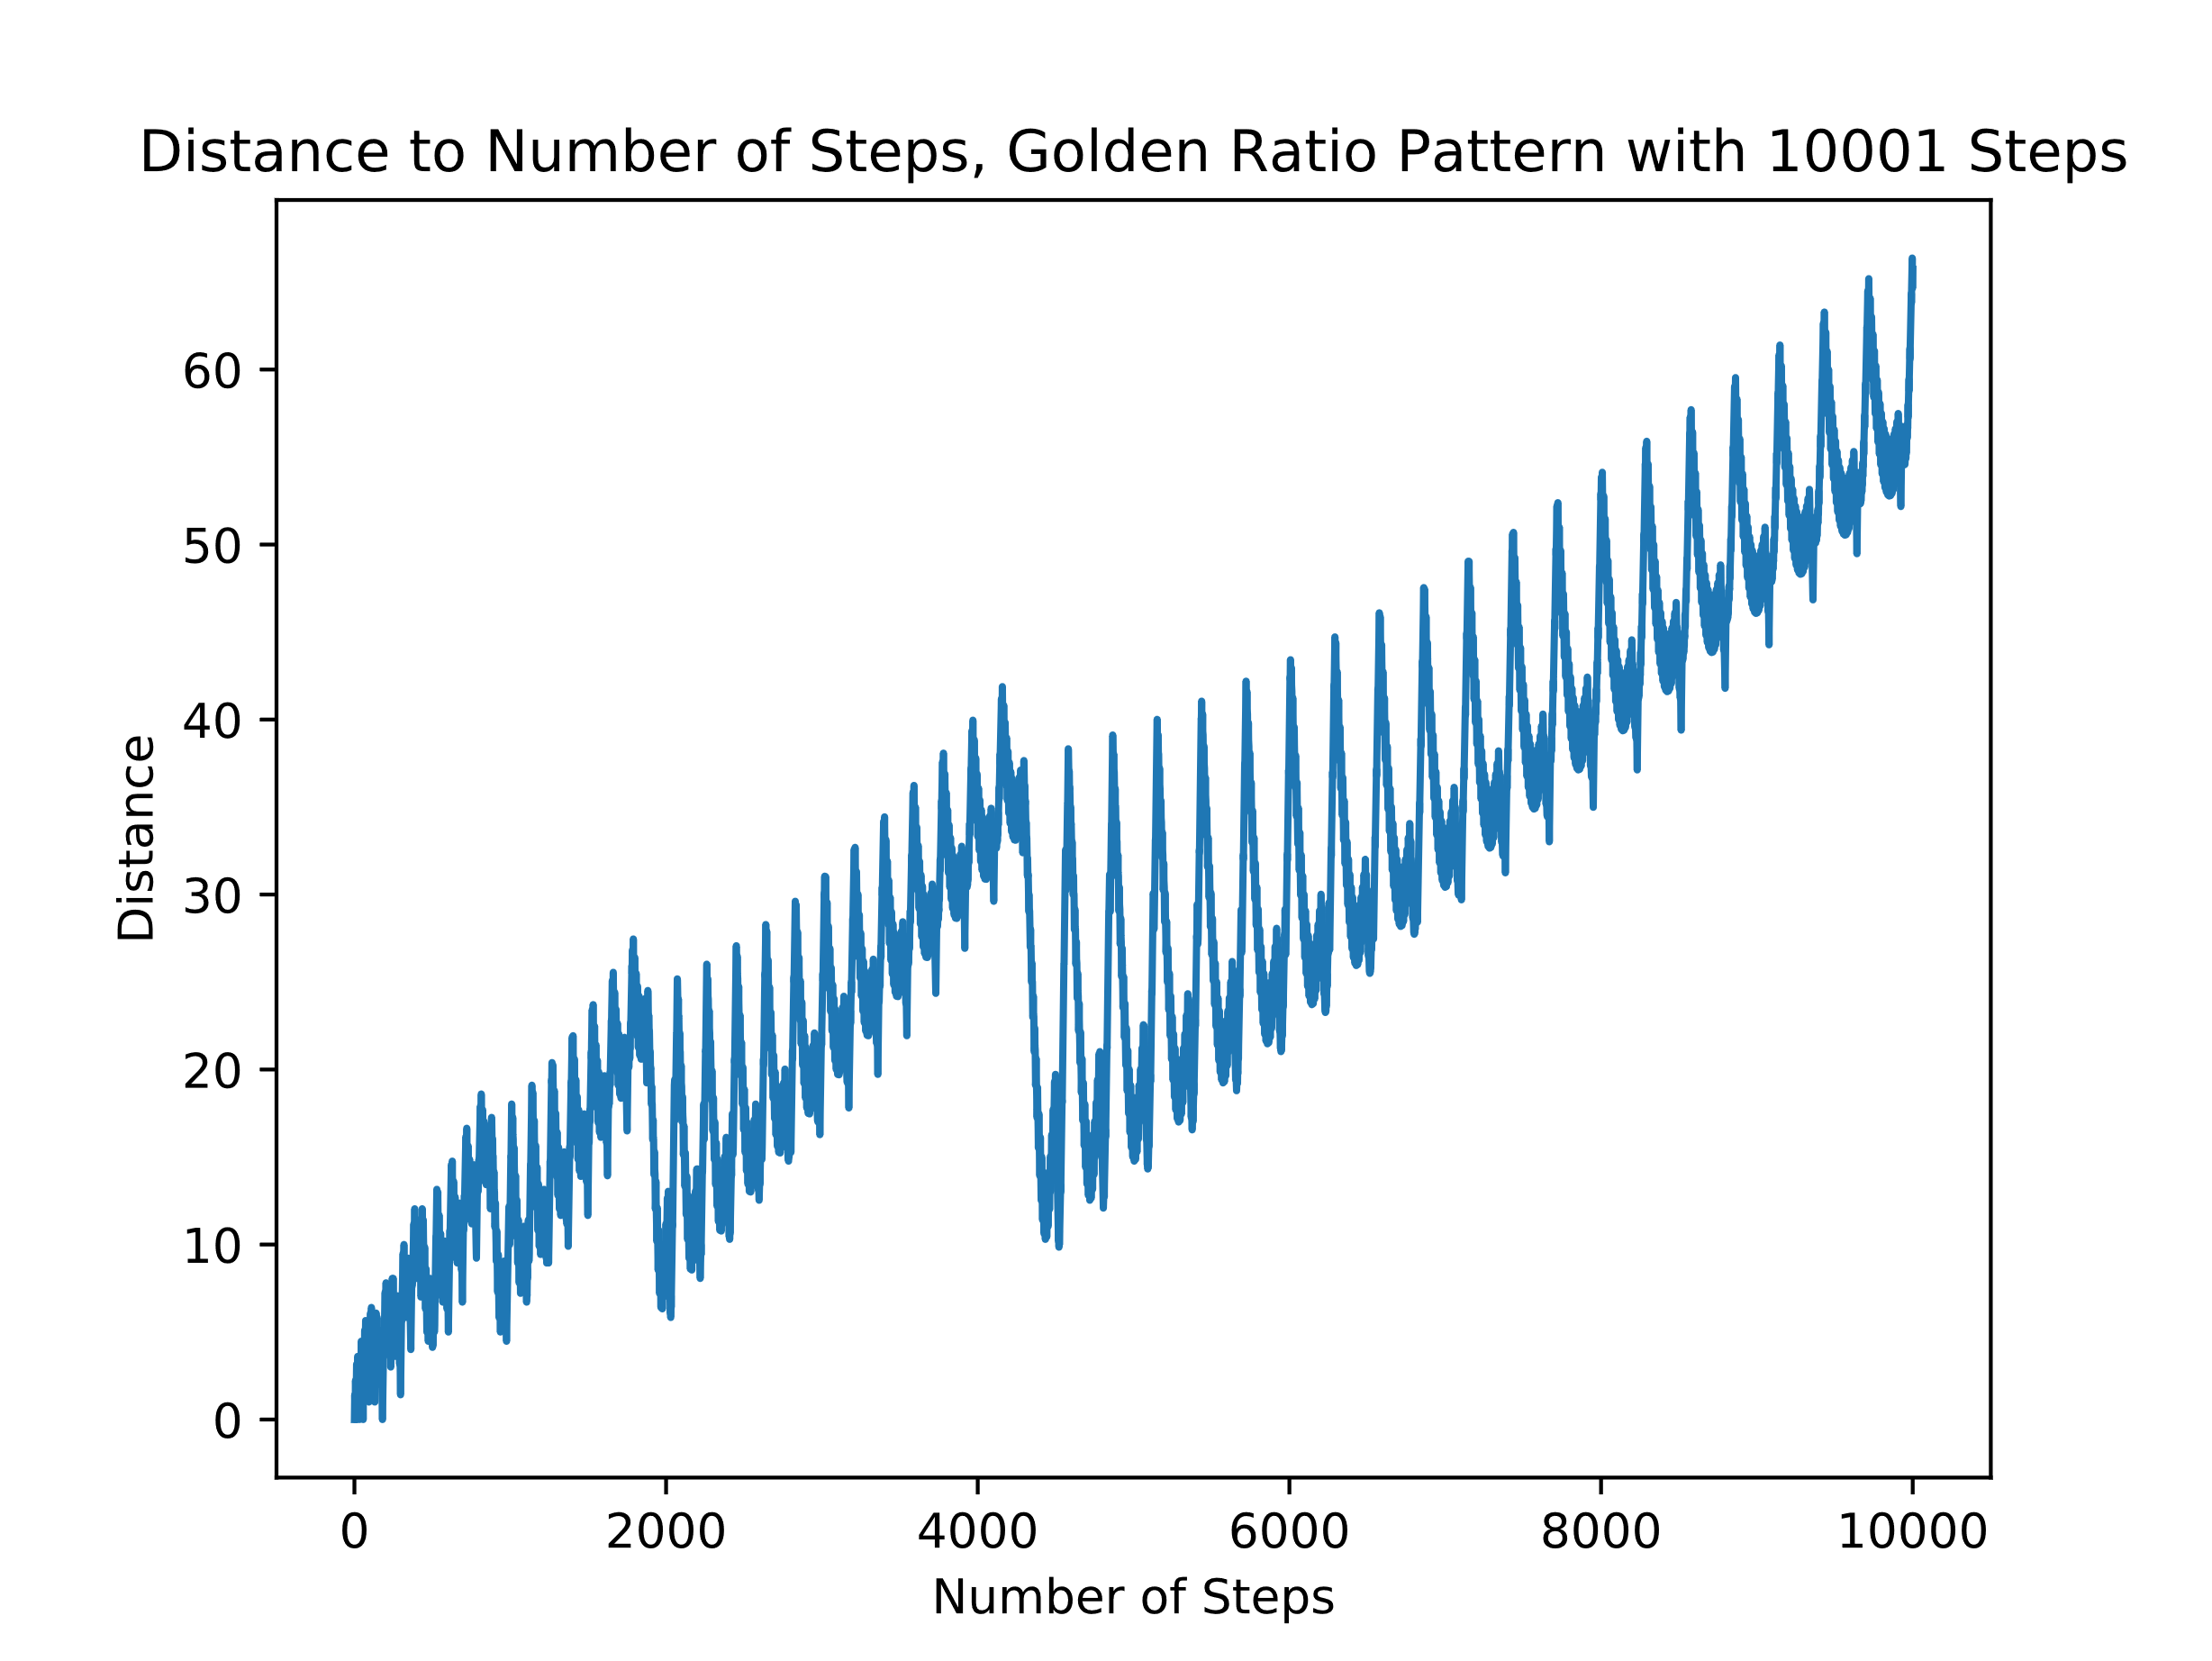
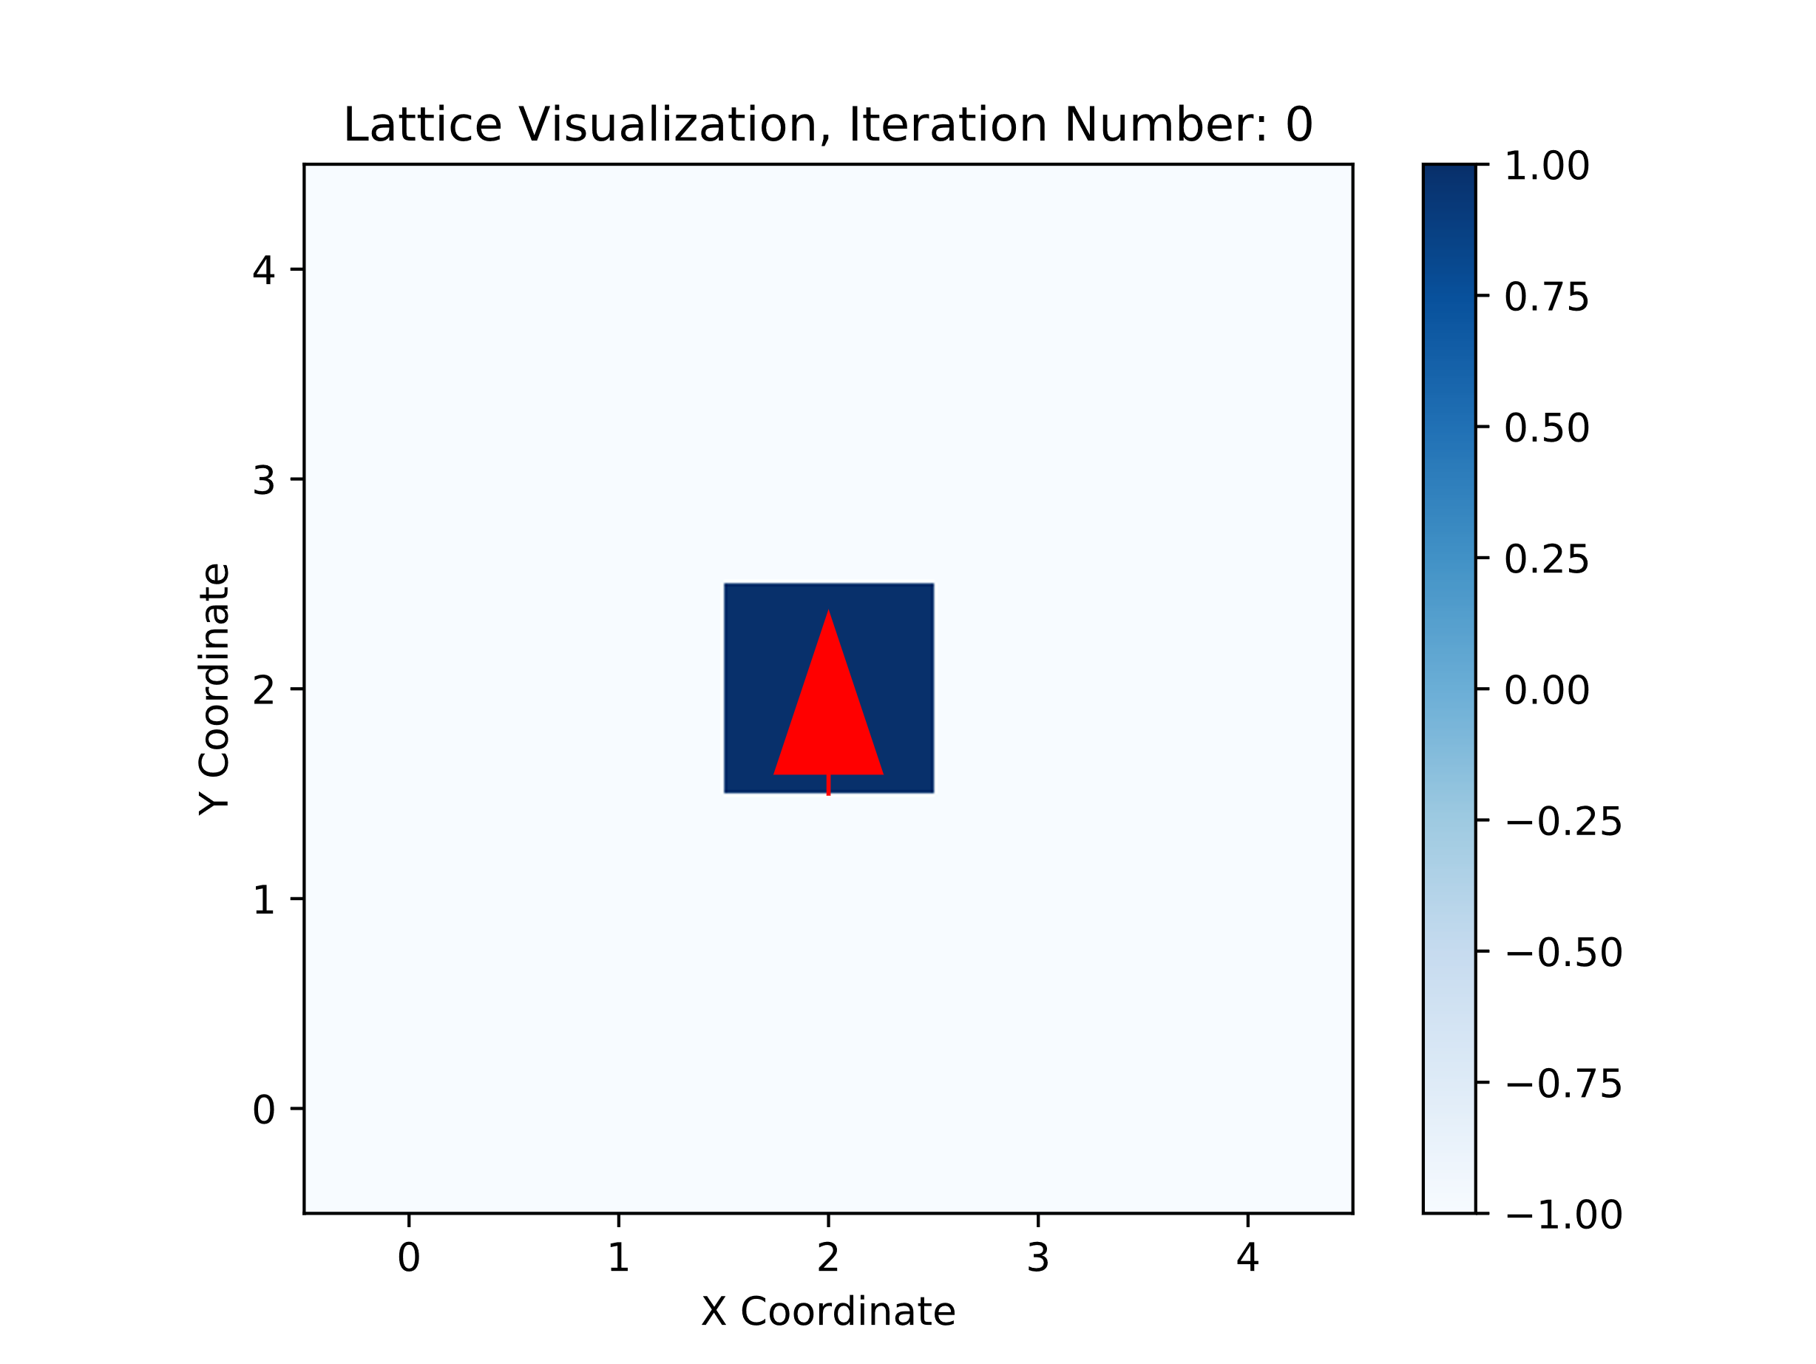
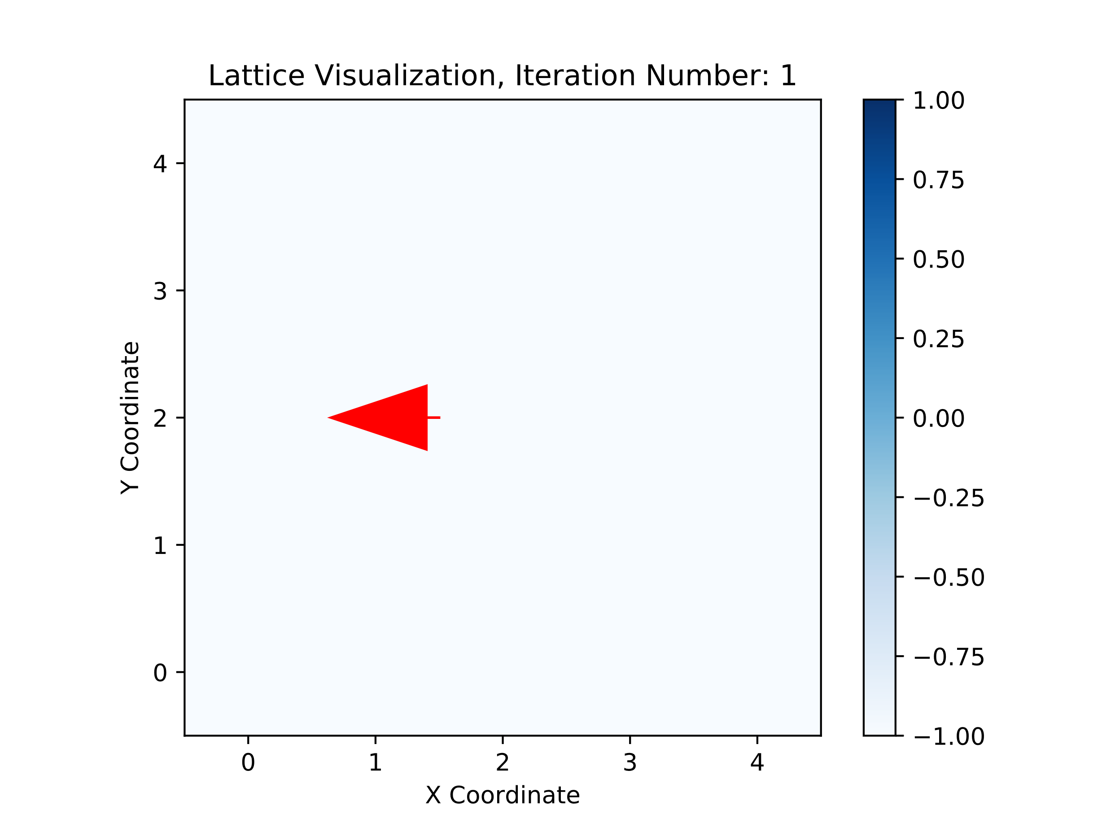
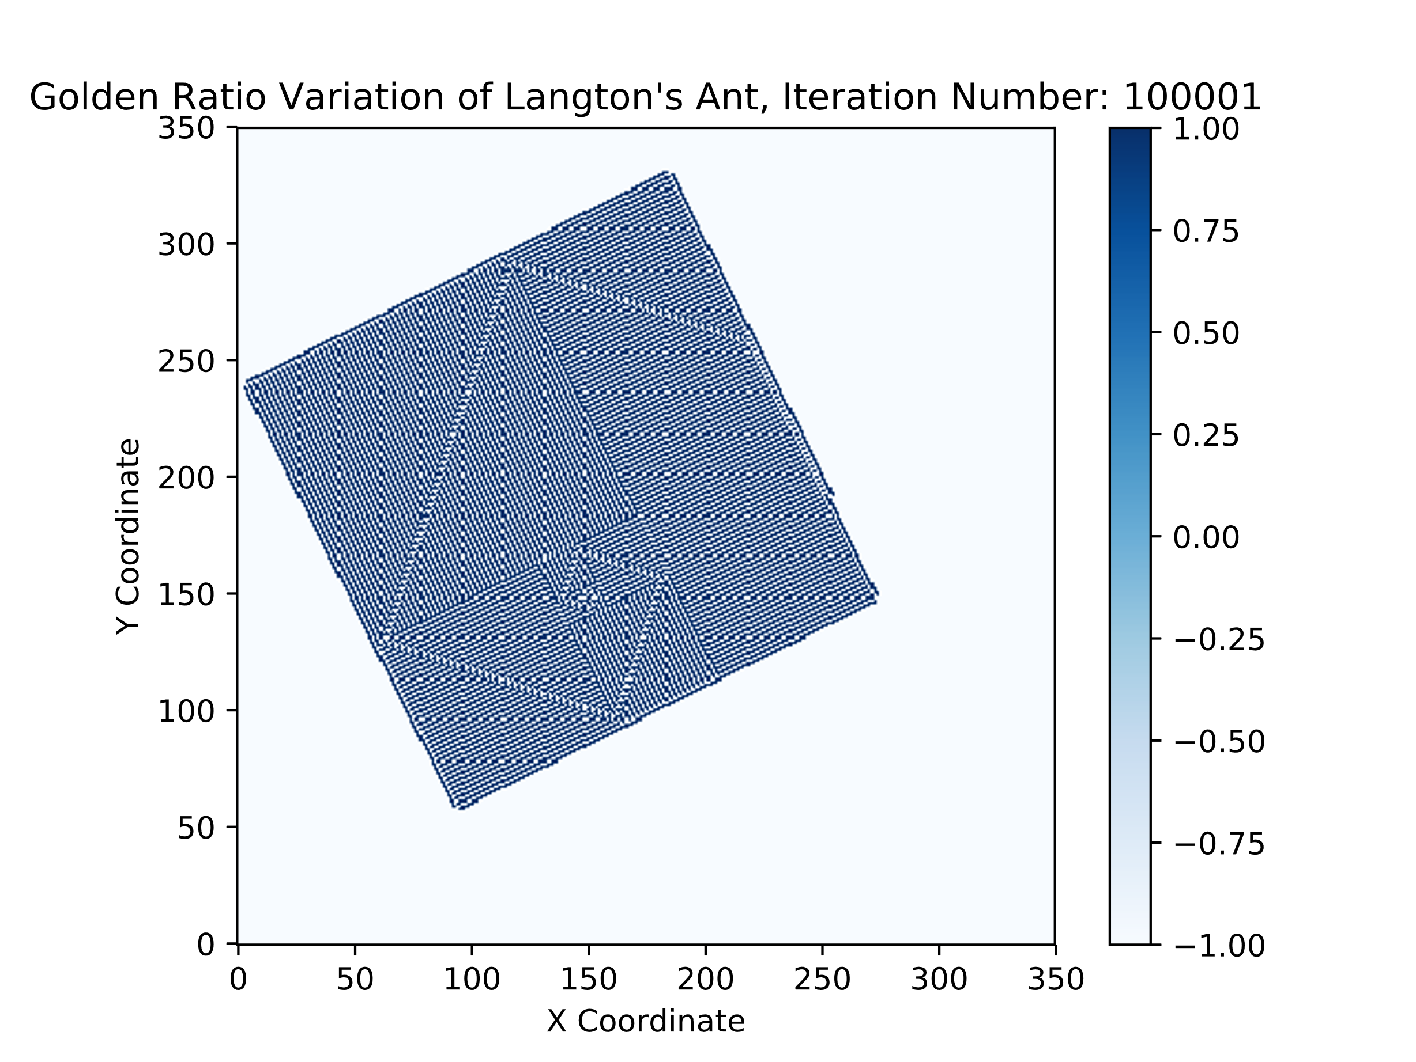
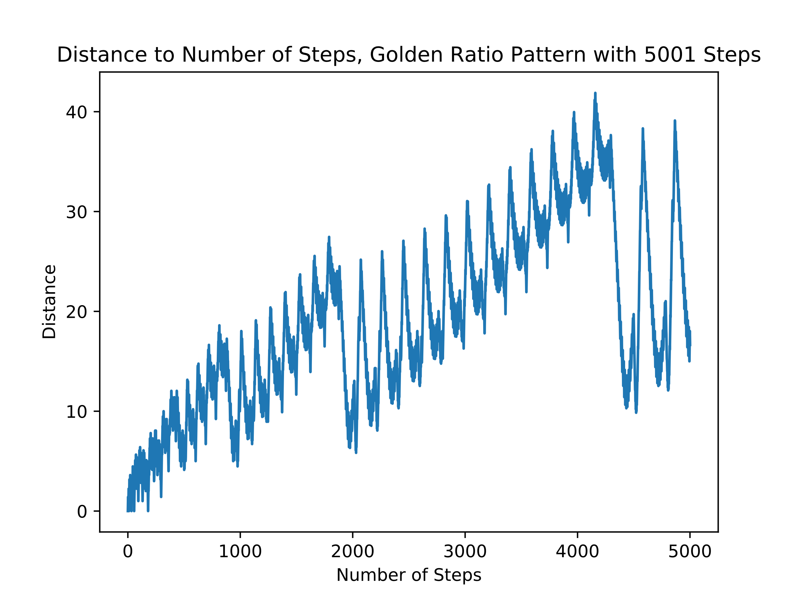
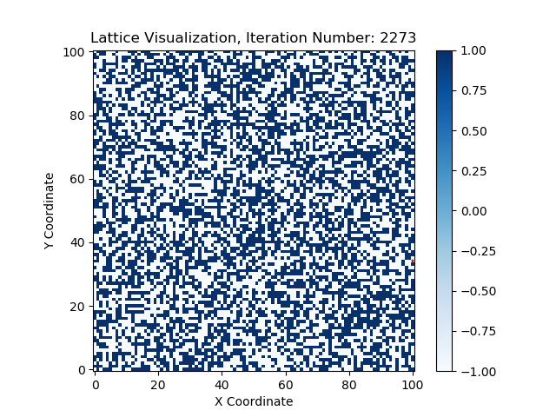
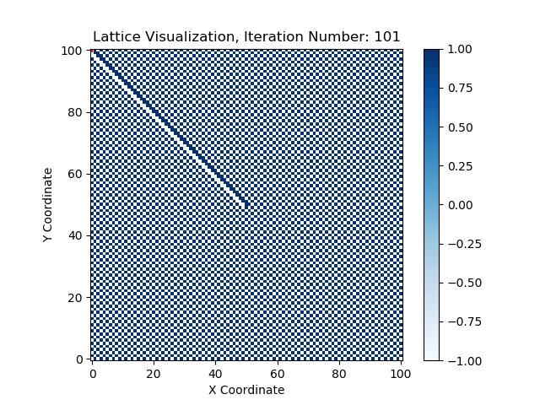
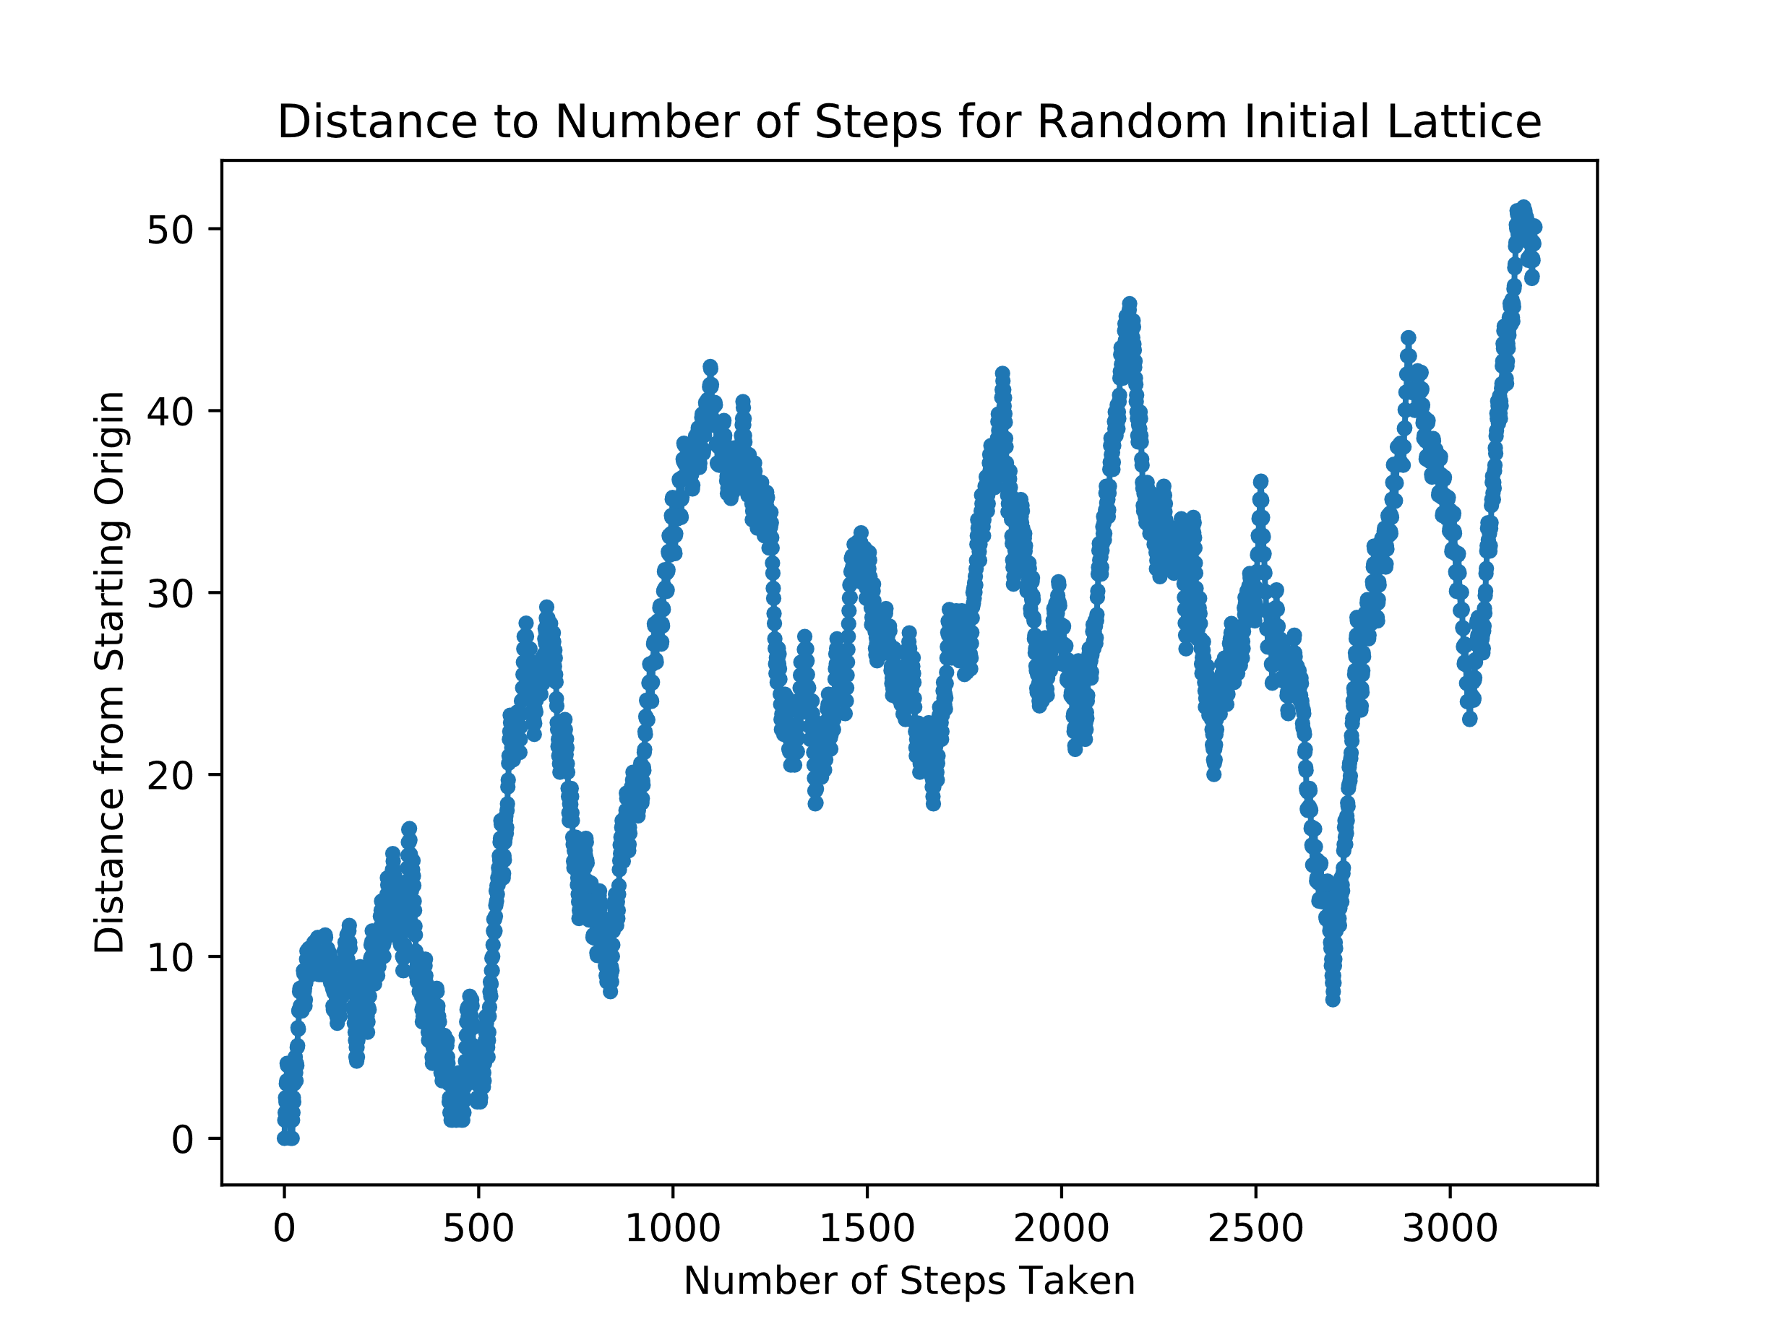
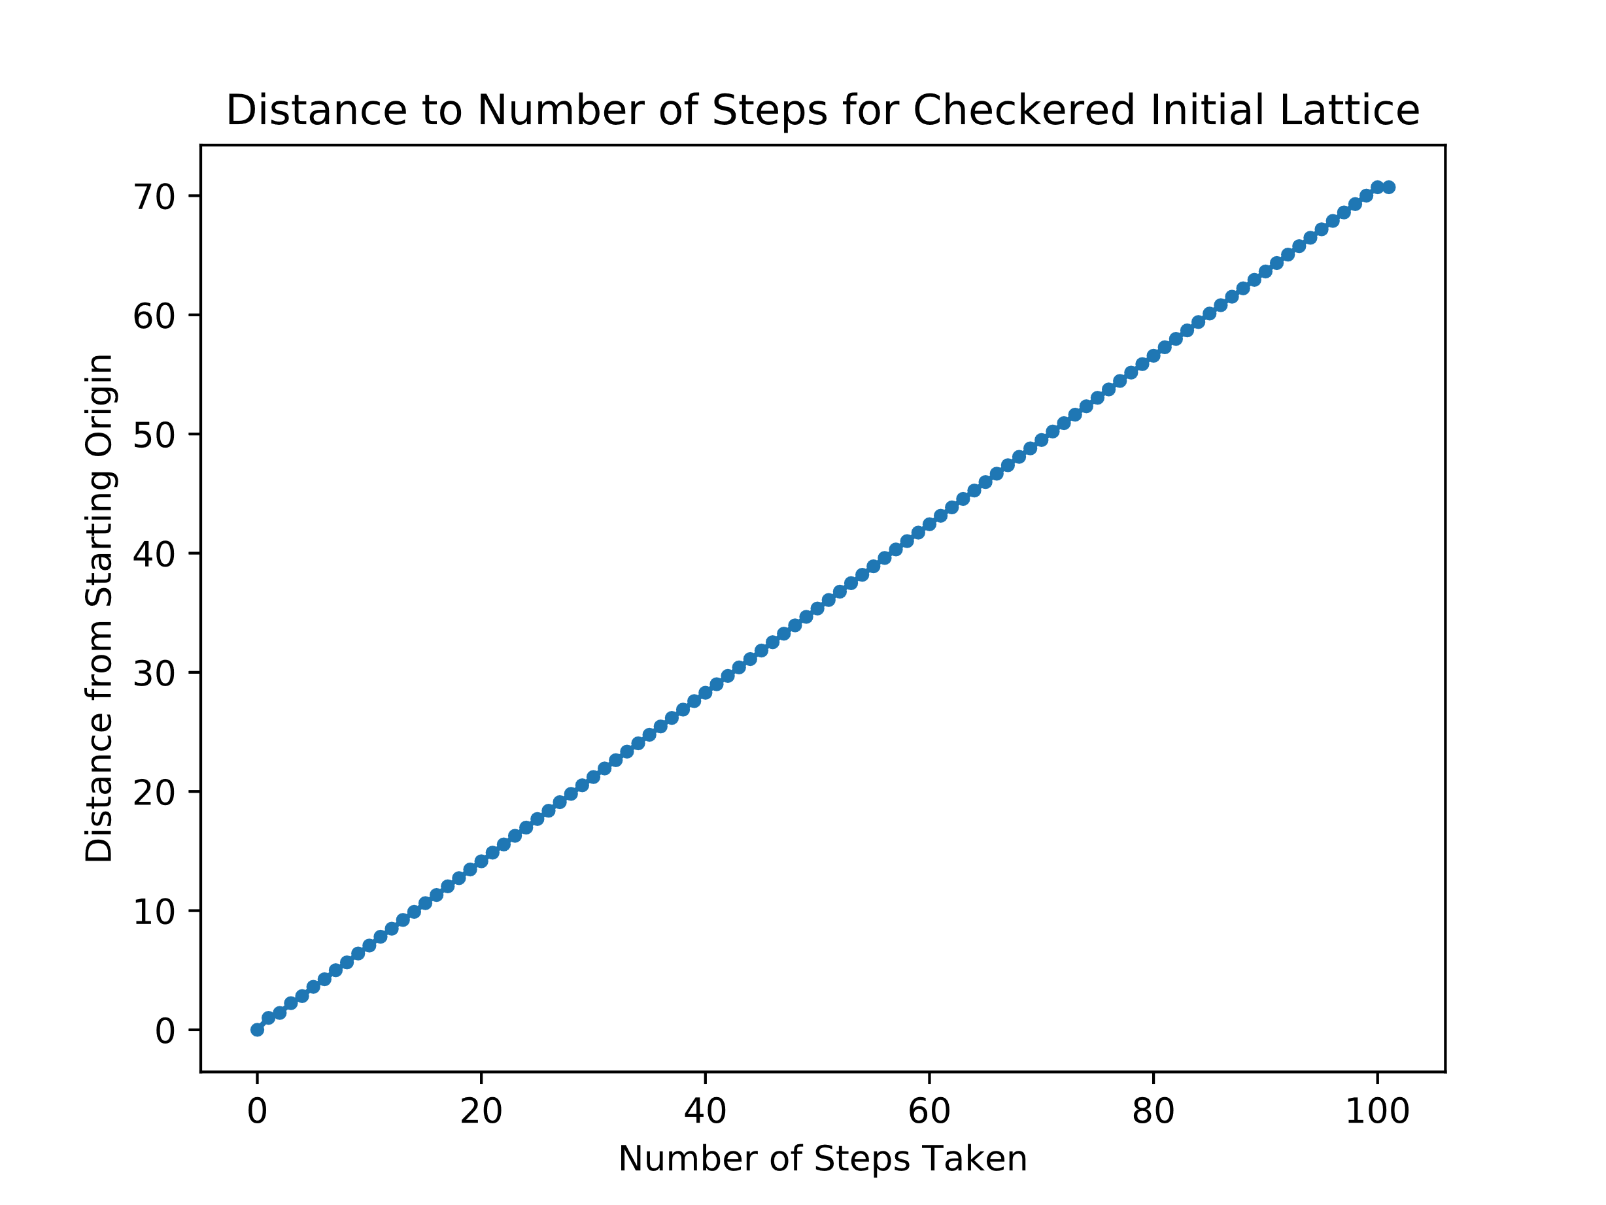
Langton’s Ant
Hope Lee
Github Repository:
Introduction
Three Phases of Behavior Visualized
Turmites
Langton’s Ant is a variety of cellular automata, similar to Conway’s game of Life. The set-up and rules for Langton’s Ant’s basic algorithm is very straightforward. The simulation consists of a grid whose cells can be either black or white, with basic simulations starting with a fully white grid. An ant is then positioned at some initial starting location and its subsequent motion governed by two rules:
If at a white cell, turn 90 degrees right, flip the cell color, then move forward one cell
If at a black cell, turn 90 degrees left, flip the cell color, then move forward one cell
Demonstration of behavior of ant at a white cell:
Demonstration of behavior of ant at a black cell:
First Phase: Simplicity
Turmites are a generalized form of Langton’s Ant, where the ant now also possess an internal ‘state’ which it is aware of at all times. By deliberately creating specific rules for the ant, specific patterns can be generated. Turmites have been proved to be universal and equal to a Turing machine. For these examples, there are two states for the Turmites.
Spiral
Golden Ratio
Second Phase: Chaos
If ant is in state 0:
At a white cell: Flip cell, move forward, keep state
At a colored cell: Keep cell, turn 90 degrees left, move forward, flip state
If ant is in state 1:
At a white cell: Flip cell, turn 90 degrees right, move forward, keep state
At a colored cell: Flip cell, move forward, flip state
Third Phase: Emergent Order
If ant is in state 0:
At a white cell: Flip cell, turn 90 degrees left, move forward, flip state
At a colored cell: Keep cell, turn 90 degrees left, move forward, flip state
If ant is in state 1:
At a white cell: Flip cell, turn 90 degrees right, move forward, keep state
At a colored cell: Flip cell, move forward, flip state
Randomness and Order in Initial Lattice
Phases of Behavior
Applications
As a Langton’s Ant system is allowed to evolve, three phases of behavior emerge:
Simplicity
Chaotic
Emergent Order
By the Cohen-Kong theorem, the final behavior of the ant will always be unbounded.
Studies of artificial life and biochemistry
Image encryption and scrambling
Simulations of Lorentz lattice gas
Wang, Xingyuan, and Dahai Xu. “A Novel Image Encryption Scheme Using Chaos and Langton’s Ant Cellular Automaton.” Nonlinear Dynamics, vol. 79, no. 4, 2014, pp. 2449–2456., doi:10.1007/s11071-014-1824-0.
Eggertsson, Hannes P. Turmites. 17 Mar. 2014, notendur.hi.is/hh/kennsla/rrr/turmites_HannesPetur.pdf.
Moreira, AndreS, et al. “Dynamical Behavior and Complexity of Langton's Ant.” Complexity, vol. 6, no. 4, 2001, pp. 46–52., doi:10.1002/cplx.1042.
Bunimovich, L. A., and S. E. Troubetzkoy. “Recurrence Properties of Lorentz Lattice Gas Cellular Automata.” Journal of Statistical Physics, vol. 67, no. 1-2, 1991, pp. 289–302., doi:10.1007/bf01049035.
Langton, Christopher G. “Studying Artificial Life with Cellular Automata.” Physica D: Nonlinear Phenomena, vol. 22, no. 1-3, 1986, pp. 120–149., doi:10.1016/0167-2789(86)90237-x.

